Slide 1
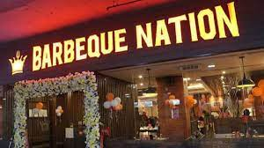
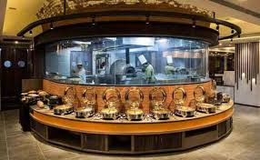
OPERATIONS MANAGEMENT
KONARK SHARMA(200517)
ANIMESH GUPTA(200126)
AUMKAR JAHAGIRDAR(200227)
ANTRIKSH DOGRA(200160)

Slide 2
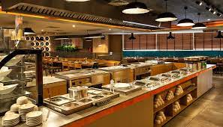
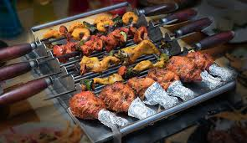
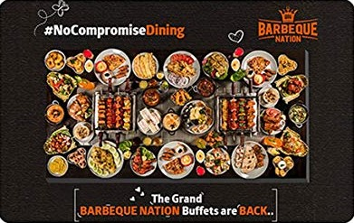

Slide 3
Overview
We all prefer to spend some quality time with our families, friends, and colleagues to take a break from our daily busy schedules. One of the best ways is to go for an outing at a perfect place to enjoy some delicious and fulfilling meal.
In a country like India, food lovers can find a lot of eating places and one of such famous restaurants to enjoy delicious food is none other than “Barbeque Nation” which is a complete package of elegancy, variety (in terms of food), and affordability. This is a place for all types of party lovers such as those who want to through a party to dance and fun time, looking for a place to sit for long conversations, food lovers, etc.
Barbeque Nation comes under India’s one of the leading casual dining chains and has adopted the “over the table barbeque” concept to facilitates guests with grill option of their own barbeque and that too at their tables. The menu of the brand includes both vegetarian and non-vegetarian dishes that are mostly as per Indian cuisine. Also, the seasonal preferences of customers are used in introducing new dishes. The place is well articulated and arranged for different types of celebrations as well like office parties, birthday parties, anniversaries, kitty parties, and many more. Different famous food festivals are also organized at the restaurants of Barbeque Nation so that customers can experience different Indian and International cuisines.

Slide 4
INTRODUCTION
we ar
The Barbeque nation is one of the most famous food supply chains that is well known in there market for great services and experience.
Here we are going to study in depth about the barbeque as a company and on things such as type of food they serve, affordability, their quality, supply chain management, customer care, ambience and the facilities that a customer get.
The purpose of this study is to analyse the operational management strategies of the BBQ and to know what really are the various factors that have contributed to its success.
And to how this company is best in their fields and what are its success mantras.e going to study in depth about the barbeque as a company and on things such as type of food they serve, affordability, their quality, supply chain management, customer care, ambience and the facilities that a customer get.
d to how this company is best in their fields and what are its success mantras.

Slide 5
Background-
Barbeque Nation was founded in 2006 by Late Sajit Dhanani, the brother of the current Managing Director of Barbeque Nation. Sajid Dhanani, who handled the popular hotel chain “Sayaji” in Indore, experienced complaints from customers regarding cold appetizers during the cold weather of winters in 2006. To resolve these complaints, he came up with the idea of making an experiment to serve a table of customers with a “live grill”. The first branch of the restaurant was opened in Pali Hills in Mumbai, and the restaurant witnessed massive growth by opening 18 more branches in a short duration. In 2014, the concept of “Kulfi Nation” was introduced, allowing customers to select from 8 kulfi flavors.
In 2015, “live counters” were opened at its outlets in which food as per the preference of customers would be cooked by the chef. Today, the brand is operating 138 outlets across India, 1 in Oman, 5 in UAE, and 1 in Malaysia.

Slide 6
Business Model
Key Initiatives
Value Proposition
Key Resources
Customer Relationship
Cost structure

Slide 7
Key initiatives
Dining of Food and Beverages
Barbeque Nation is indulged in offering different varieties of both vegetarian and non-vegetarian starters along with main courses, a famous dessert innovative menu. Their services are prompt and the dining environment at their restaurants is also very casual and pleasant.
Different food festivals are organized by the brand on a periodic basis at their restaurants in which customers are offered Indian, Fusion, and International cuisines. Different beverages, desserts, and north Indian dishes with kabab are also served to customers.

Slide 8
Marketing and Promotional Activities
Barbeque Nation is indulged in various marketing and promotional activities and the brand launches different promotion campaigns on regular basis. The brand has adopted below types of marketing strategies to promote and advertise its products and services:
Influencer marketing
Social Marketing
Video Marketing
Offline Promotion
Customer Segment

Slide 9
Value Proposition
Diversified Menu
Barbeque Nation offers a value proposition in its “All you can Eat” menu and in addition to this, it provides best-in-class service as well to customers at their restaurants. The customers of the brand mostly come from a group of family, colleagues, or friends. Therefore, the brand has a diversified range of menus to fulfill the food preference of customers in a group. A specially curated menu is also designed specifically for kids.
Fixed Price Dining
The brand offers an “all you can eat” concept at an affordable fixed price in which customers can enjoy a variety of delicious food at a reasonable price. Also, as the perception of customers is more value for money, so, fixed price dining is a great choice of relatively bigger groups.

Slide 10
Attractive and Casual Dining Environment
Barbeque Nation’s value proposition also reflects in its distinctive and attractive “DIY (Do-it-yourself) cuisine along with the concept of cooked-at-the-table. In the DIY cuisine system, it allows customers to create dishes of their own choice and as per their individual tastes by offering both fun and flexibility to mix and match a vast variety of non-veg., vegetables, condiments, and sauces. “Live Counters” are there to allow customers to get the food cooked according to their choice.
Regular Innovation in Menu
Barbeque Nation does innovation in both technical aspects and enhancing customer experience by introducing new items in the menu in a more delicious and attractive way. A great example of their menu innovation can be seen in their different 7-8 counters including vegetarian lice counter, live jalebi counter, daal counter non-vegetarian live counter, live soup counter, etc.

Slide 11
Key Resources
Website
Through its website, www.barbequenation.com, Barbeque Nation manages its business operations. The website has all the details about the various locations where the restaurant services of the brand are offered. Additionally, a detailed menu listing all of the food options is available, and a tab labelled "Today's Menu" allows customers to view the menu for that day. Through the website, they can also book tables.
Mobile Application
Customers can use the brand's mobile app, BBQN App, to access all services, including menu browsing and table reservations. Customers can use the app to find both the upcoming and closest Barbeque Nation locations.

Slide 12
Employees
Barbeque Nation's workforce is a key resource, with well-trained employees with the necessary skills and expertise. The company has different work-life balance programs and employee benefit policies, as well as celebration programs to increase morale, encourage achievement, and enhance retention. These programs are organized to increase morale, encourage achievement, and enhance retention.

Slide 13
Customer Relationships
SMS Communication
Barbeque Nation uses an SMS communication facility to manage effective communication with customers. This includes SMS for reservation confirmation, SMS for reservation cancellation, and SMS related to any ongoing updates and offers. Through these facilities, the brand maintains effective communication with its customers, resulting in better customer satisfaction and an increase in rapport. Customers are able to get continuous updates for their bookings and any ongoing offers through a secured SMS facility, making the operations of Barbeque Nation both seamless and reliable.
Smile Club
Smile Club Barbeque Nation has a loyalty program called "Smiles" which provides complementary benefits for customers.

Slide 14
Customers can earn smiles every time they enjoy the cuisine at the restaurant, which can be redeemed on the next visit to any outlet of Barbeque Nation. Each smile earned is counted as a rupee, so customers are rewarded to bring a smile to their faces.
Call center
Barbeque Nation's call center services are available to help customers with booking schedules, new offers, discount vouchers, outlet details, and menu details. Executives are available to assist customers.
Customer Care Helpline
Barbeque Nation has a customer care helpline service to serve its customers efficiently. Customers are assisted by customer care executives who answer queries and provide fast solutions. A dedicated helpline customer care number is available for customers to reach out to solve issues, provide feedback, lodge complaints, and gather detailed information.

Slide 15
Key Partners (Investors)
Lead Investors such as CX Partners, Jubilant FoodWorks, and Alchemy Capital Management are the key partners of the brand.
Key Channels
Print Media, Television, Boards
In order to generate awareness and promote its products and services, Barbeque Nation uses different print media resources such as newspapers, magazines, and others. Also, the brand runs promotion campaigns on television as well.
Social Media
Barbeque Nation runs different campaigns and publishes advertisements on different social media platforms such as YouTube, Facebook, Hotstar, Instagram, Linkedin, Twitter, etc.

Slide 16
Cost Structure
The main components of the cost structure of Barbeque Nation include the cost of consumption of food and beverages, expenses related to employee benefits, and other operating expenses.
FY2020, the brand spent INR 2,752.97 million on the consumption of food and beverages, INR 1,778.63 million on employee benefits, and INR 1,776.51 million on other operating expenses.
Barbeque Nation reported total revenue of INR 7903.58 million in FY2020. Out of this total revenue, revenue from operations was INR 7870.52 million and other income stood at INR 33.06 million.

Slide 17
THANK YOU !!!!!

